Slide 1
Vitamins
Vitamins: An organic molecule, essential in trace amounts that must be obtained in the diet because it is not synthesized in the body.
Vitamins are classified as water-soluble and fat-soluble.

Slide 2
Antioxidants
a substance that prevents oxidation by reacting itself with an oxidizing agent
helps protect us against active oxidizing agents that are by-products (free radicals) of normal metabolism
a free radical is an atom or molecule with an unpaired electron
free radicals quickly gain stability by picking up electrons from nearby molecules, which are thereby damaged
our main dietary ones are: vitamin C, vitamin E, Β-carotene, and the mineral selenium

Slide 3
Vitamins
Water-soluble
thiamine
riboflavin
niacin
B₆
folic acid
B₁₂
biotin
pantothenic acid
C
Fat-soluble
A
D
E
K

Slide 4
Immobilization of Enzyme/Cell…or any for stability

Slide 5
About Immobilization types.
Immobilization methods.
Immobilization procedure.
Advantages of immobilization techniques.
Review on production of antibiotic, acids, enzymes, alcohols by immobilized cells.

Slide 6
What is immobilization In Biotechnology.
The technique used for the physical or chemical fixation of cells, organelles, enzymes, or other proteins
onto a solid support, into a solid matrix or retained by a membrane, in order to increase their stability and
make possible their repeated or continued use.
Why do we use this technique ?
Mainly for three general reasons:
The enzyme binds in or on the beads which prevents downstream contamination of product.
The immobilized enzymes keep there activity for longer period than in solutions.
If it is co-immobilized one, when two enzymes interaction on solid support may produce intermediate (helps in further reaction before it diffuses)

Slide 7

Immobilization Techniques
entrapped
Surface bound
matrix
encapsulation
adsorbed
covalently
attached
microencapsulation
support
enzyme or
cell

Slide 8
It based on immobilized methods like adsorption, covalent bonding, cross linking, entrapment, and encapsulation.
The different methods are:
Carrier-Binding: the binding of enzymes to water-insoluble carriers
Cross-linking: intermolecular cross-linking of enzymes by bi-functional or multi-functional reagents.
Entrapping: incorporating enzymes into the lattices of a semi-permeable gel or enclosing the enzymes in a semi-permeable polymer membrane

Slide 9
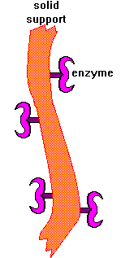
Carrier-Binding
The oldest immobilization technique for enzymes
Some of the most commonly used carriers for enzyme immobilization are polysaccharide derivatives such as
cellulose, dextran, agarose, and polyacrylamide gel.
The selection of the carrier depends on the nature
of the enzyme itself, as well as the:
- Particle size
- Surface area
- Molar ratio of hydrophilic to hydrophobic groups
- Chemical composition
the carrier-binding method can be further sub-classified into:
Physical Adsorption
Covalent Binding
Ionic Binding

Slide 10
Physical Adsorption
Of enzyme protein on the surface of water-insoluble carriers.
Advantages : no reagents and only a minimum of activation steps are required
Disadvantages : the adsorbed enzyme may leak from the carrier during use due to a weak binding force between the enzyme and the carrier. Moreover, the adsorption is non-specific, further adsorption of other proteins or other substances

Slide 11
Covalent Binding
Based on the binding of enzymes and water-insoluble carriers by covalent bonds
The functional groups that may take part in this binding are Amino group, Carboxyl group, Sulfhydryl group, Hydroxyl group, Imidazole group, Phenolic group, Thiol group, Threonine group,Indole group
Disadvantages : covalent binding may alter the conformational structure and active center of the enzyme, resulting in major loss of activity and/or changes of the substrate
Advantages : the binding force between enzyme and carrier is so strong that no leakage of the enzymes occurs, even in the presence of substrate or solution of high ionic strength.

Slide 12
Ionic Binding
Of the enzyme protein to water-insoluble carriers containing ion-exchange residues
Polysaccharides and synthetic polymers having ion-exchange centers are usually used as carriers
Advantages : the enzyme to carrier linkages is much stronger for ionic binding
Disadvantages : the binding forces between enzyme proteins and carriers are weaker than those in covalent binding

Slide 13
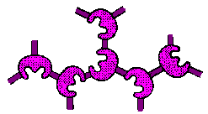
Cross-Linking
Either to other protein molecules or to functional groups on an insoluble support matrix
It is used mostly as a means of stabilizing adsorbed enzymes and also for preventing leakage from polyacrylamide gels
The most common reagent used for
cross-linking is glutaraldehyde
Disadvantages : Cross-linking reactions are carried out under relatively severe conditions. These harsh conditions can change the conformation of active center of the enzyme; and so may lead to significant loss of activity.

Slide 14
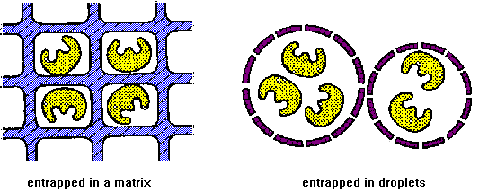
Entrapping Enzymes

Slide 15
Entrapping Enzymes
Based on the localization of an enzyme within the lattice of a polymer matrix or membrane
It can be classified into lattice and micro capsule types.
This method differs from the covalent binding and cross linking in that the enzyme itself does not bind to the gel matrix or membrane. This results in a wide applicability
Disadvantages : The conditions used in the chemical polymerization reaction are relatively severe and result in the loss of enzyme activity.

Slide 16
Depends on hydrophobic and hydrophilic properties of the substrate or reagents
Gelatin^{[2]}
K- Carrageenan^{[2]}
Agar
Sodium alginate^{[2]}
Chitosan
Agarose
Polyacrylamide
Polyvinyl alcohol and
Polyurethane foams
Others like porous particle, Pumice^{[3]} , Activated carbon, diatomaceous.

Slide 17
Cell lysis: It is carried out by sonicator, and then centrifuge 12,000xg for 15min at 4ºc. The pellet obtained after centrifugation is designated as cell debris^{[2]}
Gelatin
Take gelatin conc. Of 3-20% dissolve in 100ml of H₂0
Thermal gelling-60⁰C
and take proportion wet grams of cell debris
mixed with gelatin and maintained at 30⁰C (homozinised suspension)
Suspension was dropped into an aqueous solution of 1.5%(v/v)
It appears in beads

Slide 18
K- Carrageenan
Take 3%(w/v) of k-carrageenan in H₂0 (60⁰C)
The solution was cooled to 40-45ºC
and take proportion wet grams of cell debris
mixed with solution and maintained at 40-45⁰C (homozinised suspension)
Suspension was dropped into an aqueous solution of 2% KCl at 4⁰C (using surgical syringe)
It appears in bead

Slide 19
Sodium alginate
Take 3%(w/v) sodium alginate in H₂0
and take proportion wet grams of cell debris
mixed with solution and maintained at 4⁰C (homozinised suspension)
Suspension was dropped into an aqueous solution of 0.22M calcium chloride at 4⁰C
These beads kept for primary curing for 24h and secondary curing was done in 0.02M calcium chloride for 48h maintained at 4⁰C
Lastly traces of calcium chloride removed by thoroughly washing distilled water
It appears in beads

Slide 20
Advantages of immobilization techniques
Immobilization provides high cell concentrations
It provides reuse of c cells, eliminates cost.
Results in high product yield and rates
Protects from shear stress from cell damaging.
In some cases it improves genetic stability

Slide 21
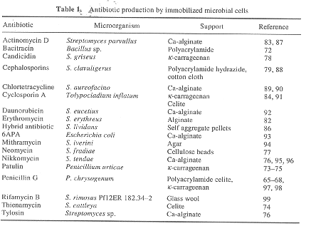
Antibiotic
[4]
Microbial fermentations with immobilized cells. (Source Internet)

Slide 22
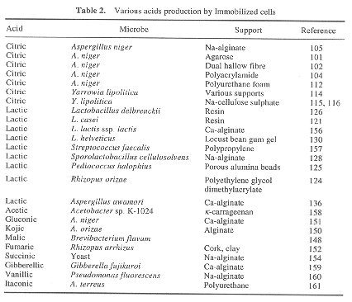
Acid
[4]
Microbial fermentations with immobilized cells. (Source Internet)

Slide 23
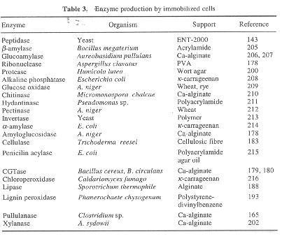
Enzymes
[4]
Microbial fermentations with immobilized cells. (Source Internet)

Slide 24
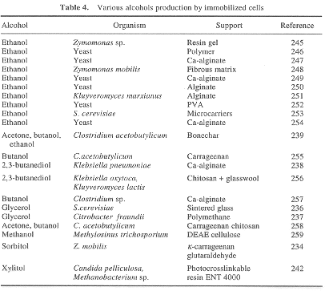
Alcohols
[4]
Microbial fermentations with immobilized cells. (Source Internet)

